Slide 1
FSI Simulation for pipeline

Slide 2
CONTENT
CFD ANALYSIS
WALL PRESTRESS GENERATION
FSI ANALYSIS
SUMMARY

Slide 3
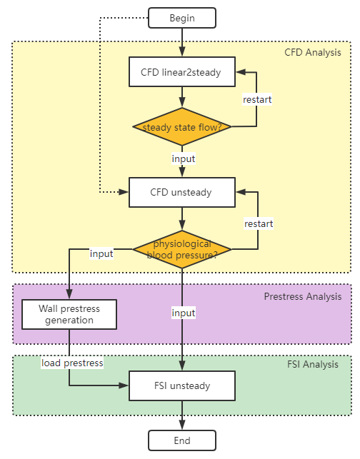
Simulation pipeline
Notes:
流程图

Slide 4
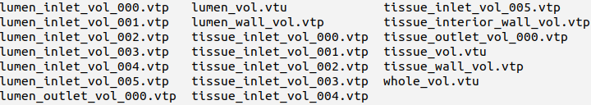
CFD ANALYSIS
Preprocessor :
prepare necessary files:
mesh files
wall boundary mesh
outlet and inlet boundary mesh
volume mesh

Slide 5
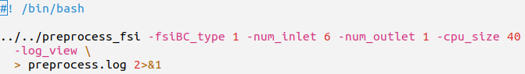
CFD ANALYSIS
Preprocessor :
assign proper boundary condition, do mesh partitioning
Eg: preprocess_cfd.sh
-fsiBC_type 1
-num_inlet
-num_outlet
-cpu_size
determines the wall is rigid
determines the number of inlets of the vascular domain
determines the number of inlets of the vascular domain
determines the number of CPUs you want to run for the analysis solver.

Slide 6
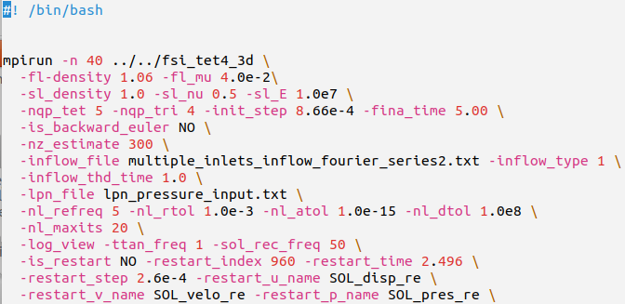
CFD ANALYSIS
-init_step
-final_time
-nz_estimate
-is_backward_euler
-ttan_freq
-sol_rec_freq
-is_restart
-restart_name
defines the time step size
defines the end time of simulation
defines the estimation of num nonzeros per rows for the tangent matrix
defines whether to use Backward Euler or Generalized-alpha method
defines the frequency of tangent matrix renewal
defines the frequency of recoding the solution
defines whether runs restart process
defines the restart solution base name
CFD-linear2steady (optional):
Eg: cfd2steady.sh
material parameters
Notes:
Restart argument
Nonlinear systems argument
Linear systems argument
Time integration argument
Numerical quadrature argument
Other argument

Slide 7
CFD ANALYSIS
-restart_index
-restart_time
-restart_step
-nl_refreq
-nl_rtol
-nl_atol
-nl_dtol
-nl_maxits
defines the restart solution time index
defines the restart time
defines the restart simulation time step size
defines the frequency of tangent matrix renewal
defines the convergence criterion relative tolerance for nonlinear iteration
defines the convergence criterion absolute tolerance for nonlinear iteration
defines the divergence criterion
defines the maximum number of nonlinear iterations
CFD-linear2steady (optional):
Eg: cfd2steady.sh

Slide 8
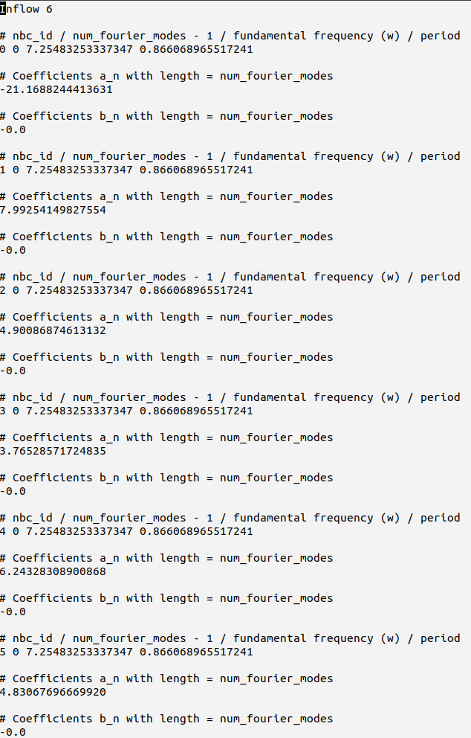
CFD ANALYSIS
CFD-linear2steady (optional):
Eg. multiple_inlets_inflow_fourier_series2.txt
-inflow_type 1
-inflow_file
-inflow_thd_time
the inlet flow is defined to linearly ramped up to steady state
specifies the inflow in terms of fourier series by reading files
time for linearly increasing inflow to reach steady state

Slide 9
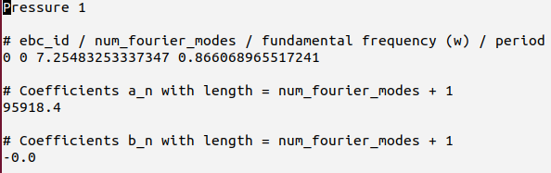
CFD ANALYSIS
CFD-linear2steady (optional):
-lpn_file
defines the LPN data for the outlets.
Eg. lpn_pressure_input.txt
At this stage, we need to generate a flow field during the diastolic period at steady state inflow.
$95918.4 (72$ mmHg)
Notes:
95918.4/1333.2=71.94 mmHg

Slide 10
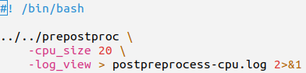
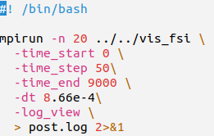
CFD ANALYSIS
Post-cfd-linear2steady (optional):
Eg: prepostprocess-cpu.sh
Repartition the mesh:
necessary files: mesh files, preprocessor_cmd.h5
specify the number of CPUs for postprocessing
Eg: post-fsi.sh
Visualize the data
necessary files: epart.h5, node_mapping_p.h5, node_mapping_v.h5
ppart folder (postprocessing mesh partitioning
generated hdf5 files), solution files, solver_cmd.h5
convert the solution files to vtk files, from time step 0 to 9000,
with incremental step being 50

Slide 11
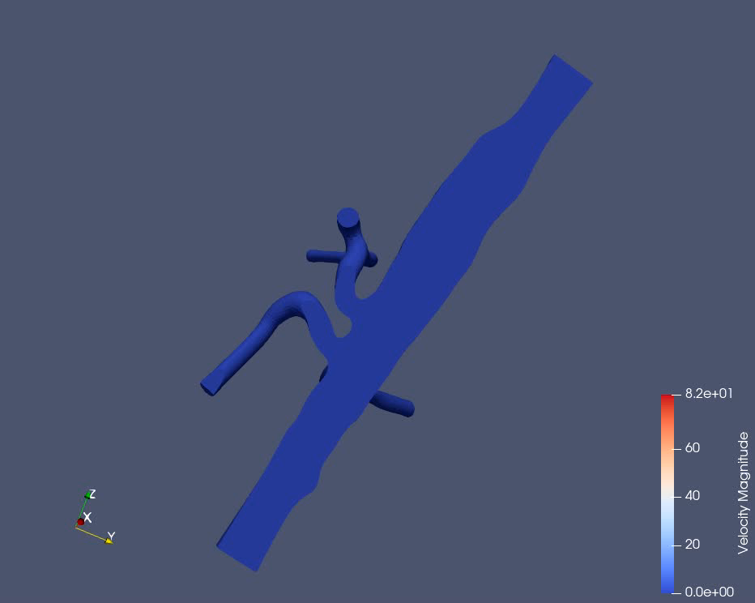
CFD ANALYSIS
CFD-linear2steady (optional):
When the flow solver runs successfully, there will be a steady-state solution
Now we can run the solver to solve for the pulsatile inflow and RCR outlet boundary

Slide 12
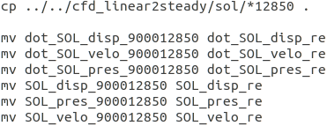
CFD ANALYSIS
CFD-unsteady:
prepare
At the upper stage, we get the steady-state solution recorded and we rename the solution files
(Assume the last step index is 12850)
make sure necessary files: apart folder (preprocessing mesh partitioning generated hdf5 files)

Slide 13
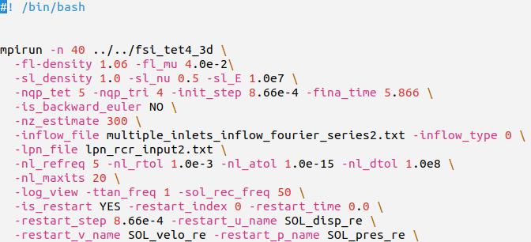
CFD ANALYSIS
CFD-unsteady:
Slove for cfd-unsteady
Eg: cfd-unsteady.sh
The result of the last steady stage is taken as the initial value of unsteady analysis
Notes:
重启参数会覆盖时间步长参数

Slide 14
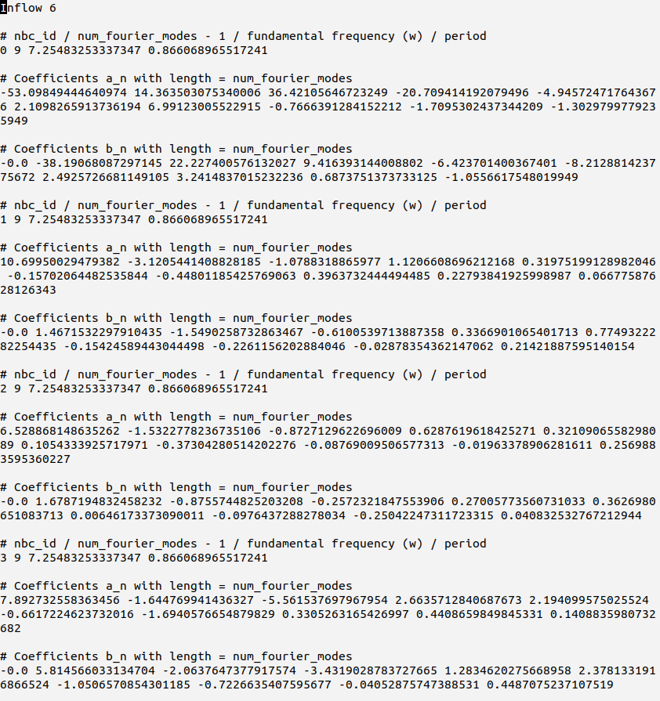
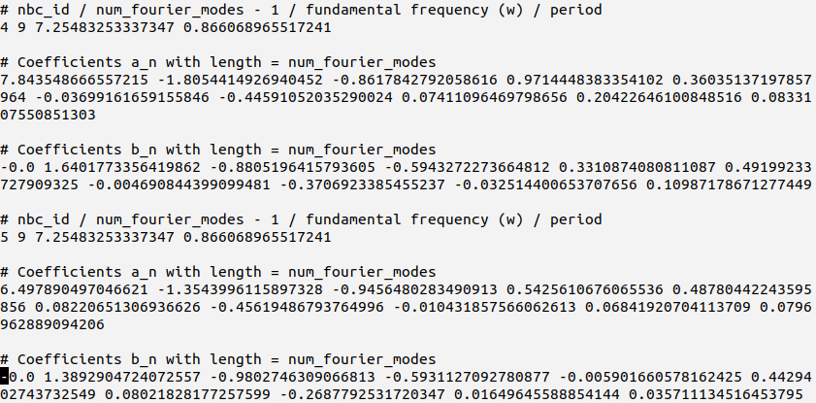
CFD ANALYSIS
CFD-unsteady:
Eg. multiple_inlets_inflow_fourier_series2.txt
-inflow_type 0
-inflow_file
the inlet flow is defined fluctuant pulsatile flow
specifies the inflow in terms of fourier series by reading files

Slide 15
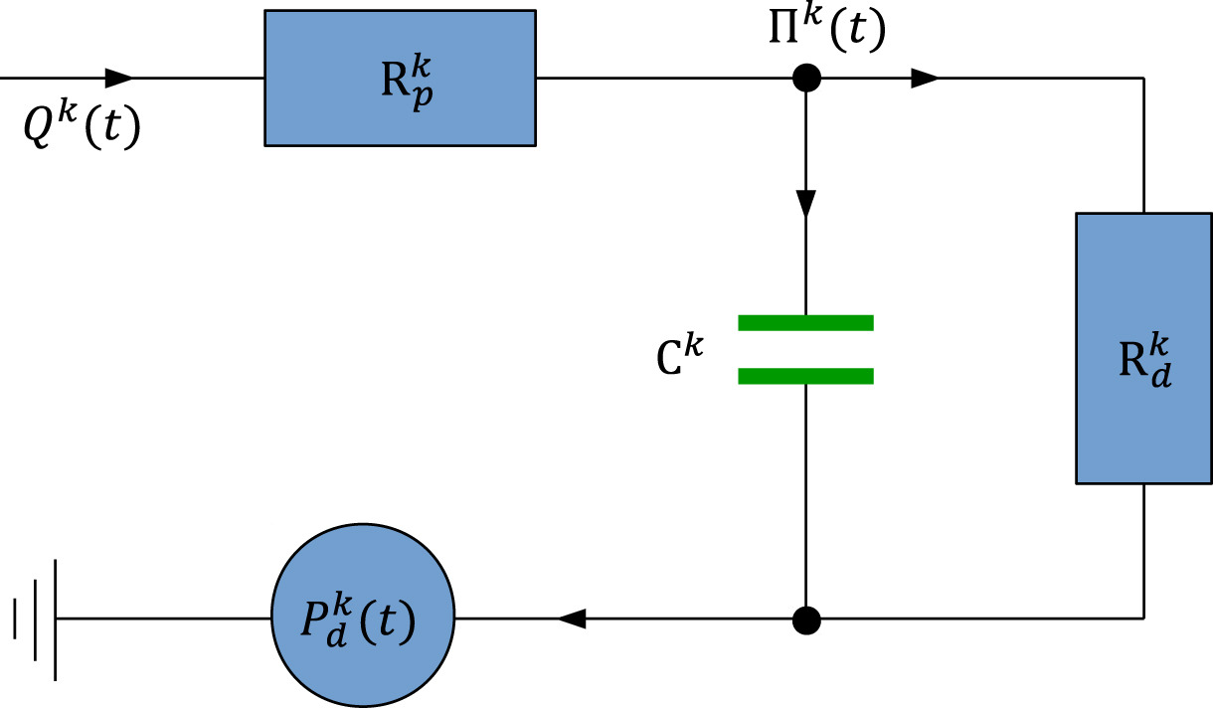
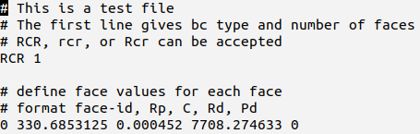
CFD ANALYSIS
CFD-unsteady:
-lpn_file
defines the LPN data for the outlets.
Eg. lpn_rcr_input2.txt
Notes:
95918.4/1333.2=71.94 mmHg

Slide 16
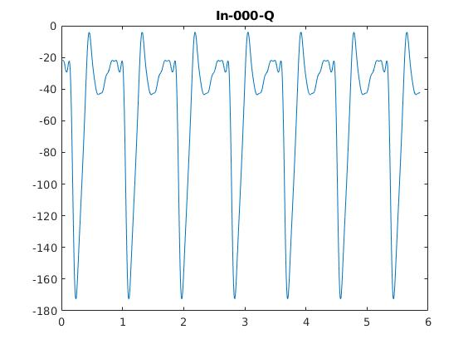
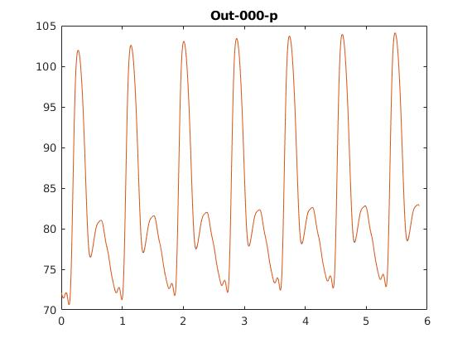

CFD ANALYSIS
Observe the outlet pressure
diastolic pressure 72.80 mmHg
The solution of flow field at this time is taken as the boundary condition of wall prestressing generation and initial condition of FSI analysis
(assume this index is 6150, and the corresponding time is 5.3259s )
Notes:
假设血管处于舒张压

Slide 17
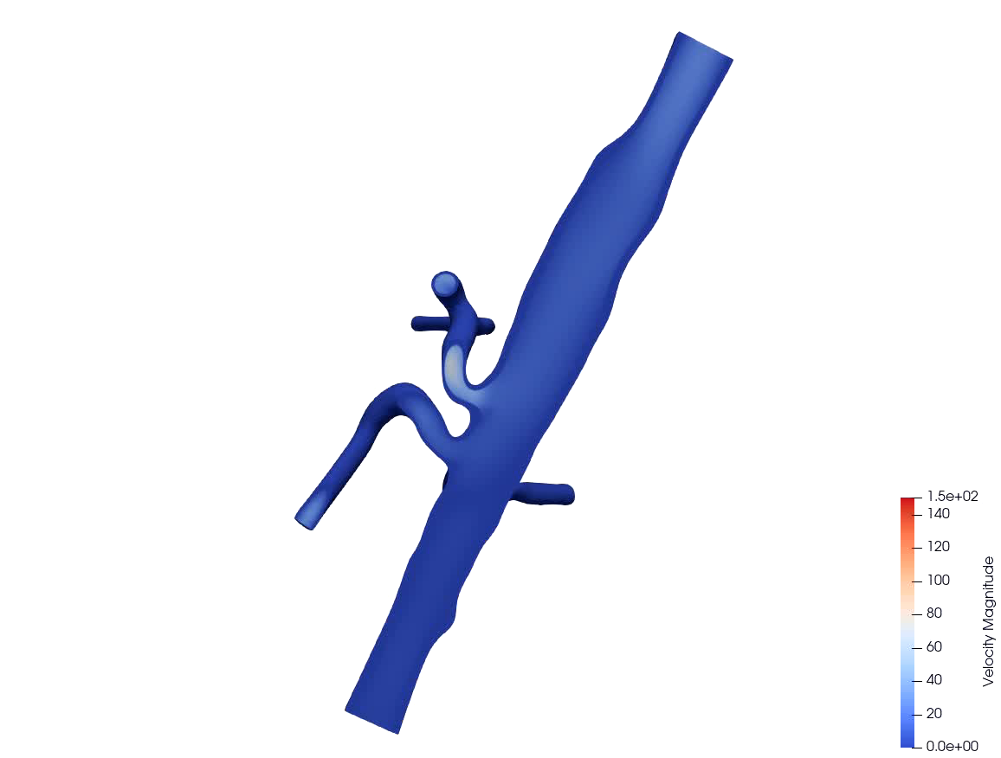
CFD ANALYSIS
CFD-unsteady:
Check whether the flow field obtained by CFD analysis conforms to physics.

Slide 18
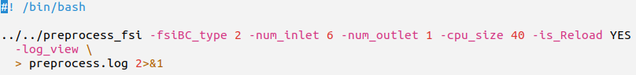
WALL PRESTRESS GENERATION
Preprocessor :
necessary files: mesh files, epart.h5 and npart.h5 from previous CFD analysis
Eg: preprocess_prestress.sh
-fsiBC_type 2
-cpu_size 40
-is_Reload YES
the variables in the fluid subdomain is fixed so that one can solve the wall mechanics for prestress
should be the same as the cpu size used for cfd analysis
check whether cpu_size is compatible with prior partition

Slide 19
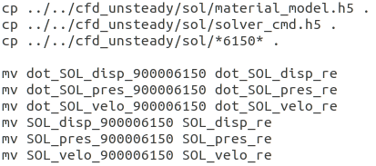
WALL PRESTRESS GENERATION
Prestress
prepare
copy the material_model.h5 solver_cmd.h5 from the CFD analysis
provide the material properties set in the CFD analysis.
copy and rename the SOL to the SOL_re from the CFD analysis
the solution of cfd-unsteady analysis saved as SOL_re

Slide 20
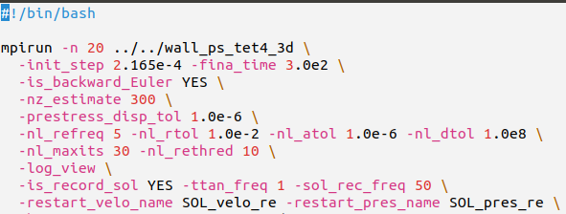
WALL PRESTRESS GENERATION
Prestress
Eg: prestress.sh
-prestress_disp_tol
-init_step
-fina_time
-is_record_sol
-is_backward_Euler
determines the stoping criterion for the fixed-point iteration
sets the time step size. As we are driving for a steady-state solution, it is recommended to make the time step large.
defines the end time of simulation
tells the wall solver if we want to save the solution files.
it is recommended to test between the Backward Euler method and Generalized alpha method
If the wall solver runs successfully, it will generate the ps_data folder and prestress_pxxxxx.h5 files

Slide 21
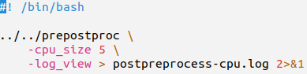
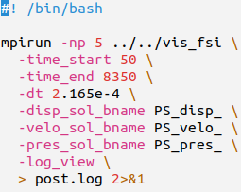
WALL PRESTRESS GENERATION
Post-prestress
Eg: prepostprocess-cpu.sh
Repartition the mesh:
necessary files: mesh files, preprocessor_cmd.h5
specify the number of CPUs for postprocessing
Eg: postvis-prestress.sh
Visualize the data
necessary files: epart.h5, node_mapping_p.h5, node_mapping_v.h5
ppart folder (postprocessing mesh partitioning
generated hdf5 files), solution files, solver_cmd.h5
convert the solution files to vtk files, from time step 50 to 8350,
with incremental step being 50

Slide 22
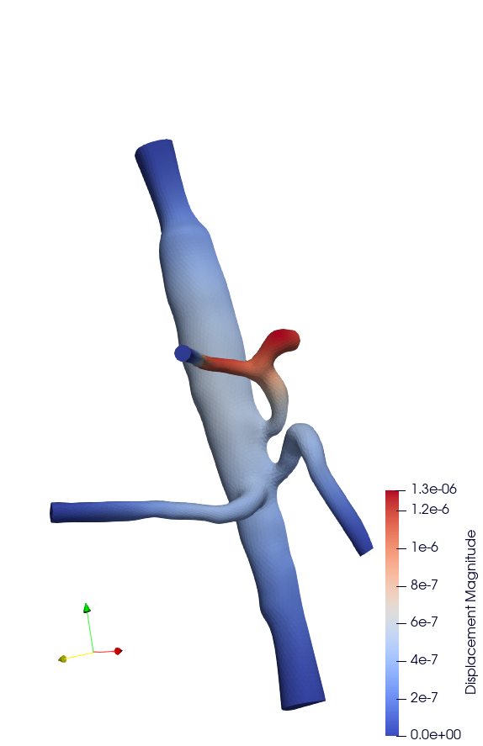
WALL PRESTRESS GENERATION
Post-prestress
Check whether the obtained displacement field from wall prestress solver is consistent with the given tolerance.

Slide 23
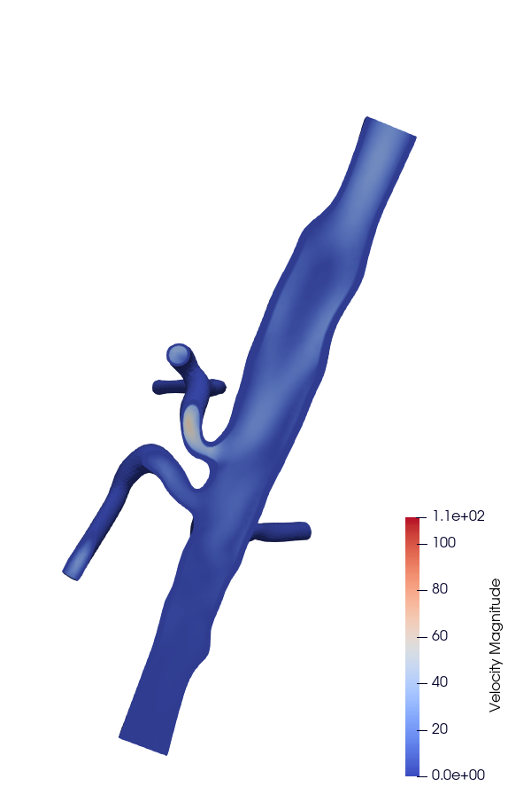

WALL PRESTRESS GENERATION
Check whether the flow field when solving the prestress is consistent with the flow field at the restart moment selected in the previous CFD analysis.
Prestress flow field
CFD flow field in 5.3295s

Slide 24
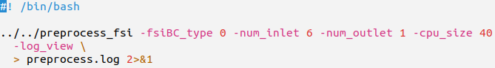
FSI ANALYSIS
Now we can rerun the preprocessor to assign boundary conditions for the deformable wall simulation.
FSI-unsteady:
necessary files: mesh files
Eg: preprocess_fsi.sh
-fsiBC_type 0
-cpu_size 40
the wall is set to be deformable
should be the same as the cpu size used for wall prestress generation
Notes:
Fsi应与prestress单元剖分一致

Slide 25
FSI ANALYSIS
FSI-unsteady
prepare
copy the prestress_pxxxxx.h5 files from previous wall prestress generation
provide the prestress obtained from wall prestress solver
copy and rename the SOL to the SOL_re from the CFD analysis
the solution of cfd-unsteady analysis saved as SOL_re

Slide 26
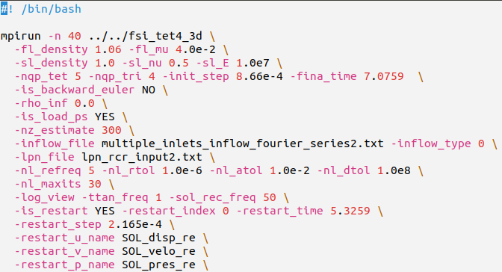
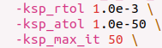
FSI ANALYSIS
FSI-unsteady
Slove for fsi-unsteady
Eg: fsi_unsteady.sh
-load_ps YES
the wall loads the prestress, which is balancing with the fluid pressure.
-restart time
-ksp_rtol
-ksp_atol
-ksp_max_it
should be the same as the restart time in the CFD analysis chosen for generating wall prestress.
defines the convergence criterion relative tolerance for linear iteration
defines the convergence criterion absolute tolerance for linear iteration
defines the maximum number of linear iterations

Slide 27
FSI ANALYSIS
FSI-unsteady:
Eg. multiple_inlets_inflow_fourier_series2.txt
-inflow_type 0
-inflow_file
the inlet flow is defined fluctuant pulsatile flow
specifies the inflow in terms of fourier series by reading files

Slide 28
FSI ANALYSIS
FSI-unsteady:
-lpn_file
defines the LPN data for the outlets.
Eg. lpn_rcr_input2.txt
Notes:
95918.4/1333.2=71.94 mmHg

Slide 29
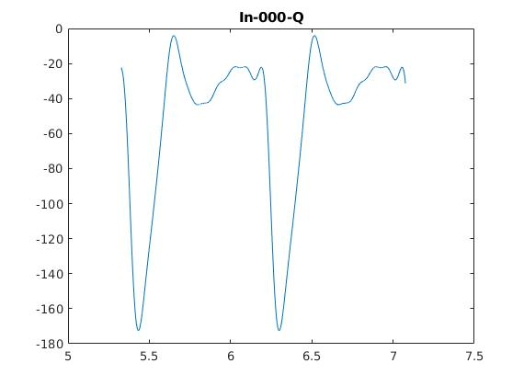
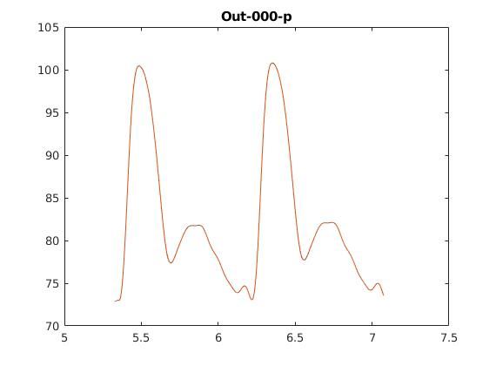
FSI ANALYSIS

Slide 30
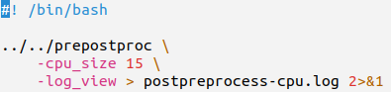
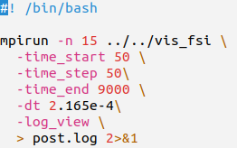
FSI ANALYSIS
Post-fsi-unsteady:
Eg: prepostprocess-cpu.sh
Repartition the mesh:
necessary files: original geometry files, preprocessor_cmd.h5
specify the number of CPUs for postprocessing
Eg: post-fsi.sh
Visualize the data
necessary files: epart.h5, node_mapping_p.h5, node_mapping_v.h5
ppart folder (postprocessing mesh partitioning
generated hdf5 files), solution files, solver_cmd.h5
convert the solution files to vtk files, from time step 0 to 9000,
with incremental step being 50

Slide 31
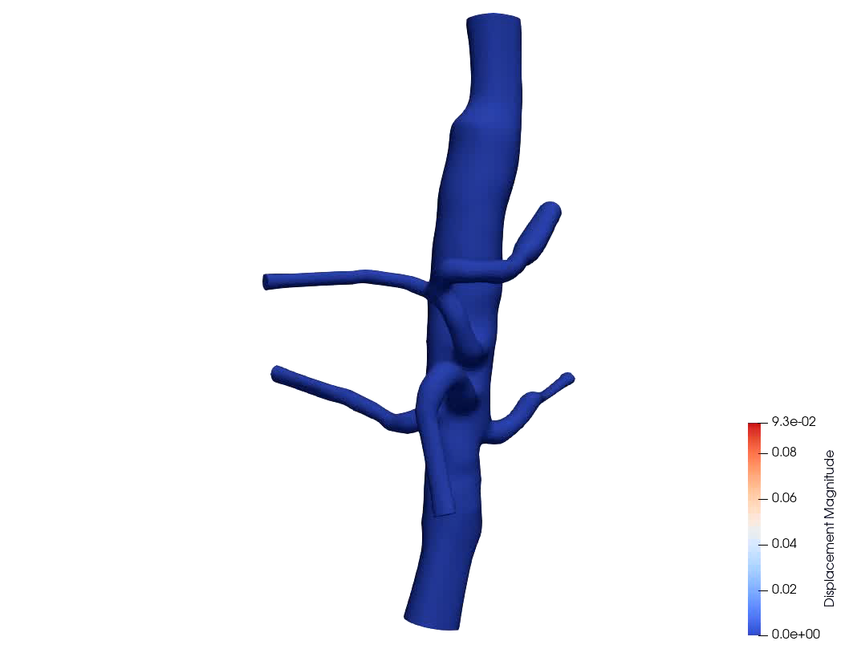
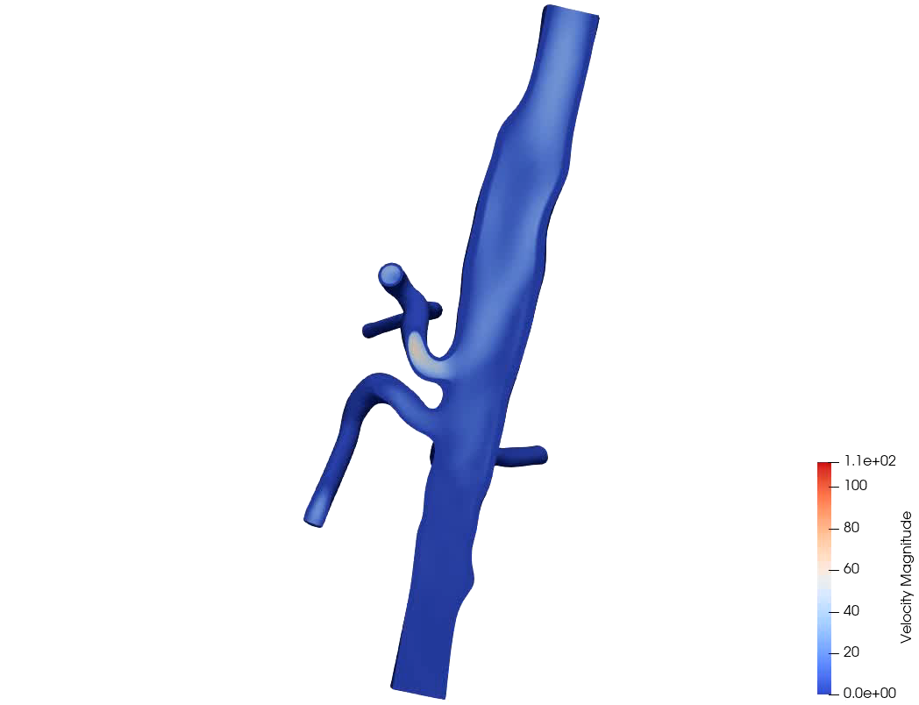
FSI ANALYSIS

Slide 32
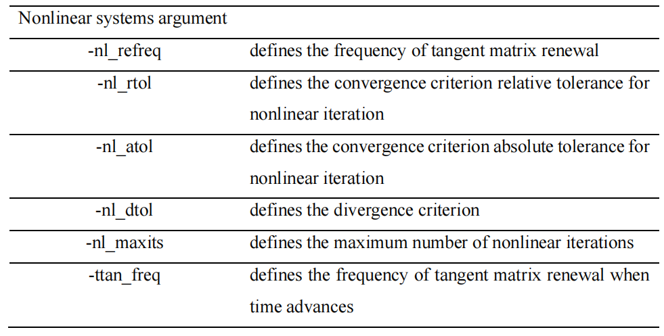
SUMMARY
Arguments

Slide 33
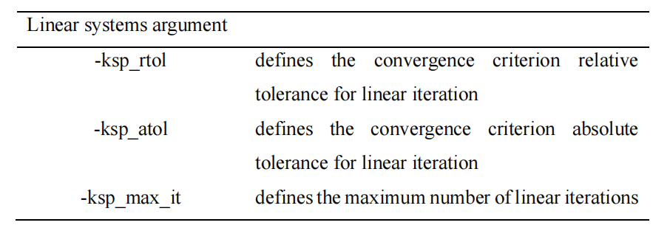
SUMMARY
Arguments

Slide 34
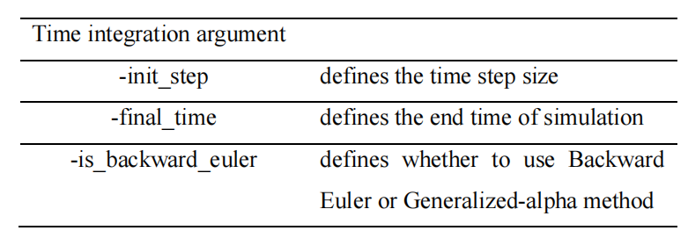
SUMMARY
Arguments

Slide 35
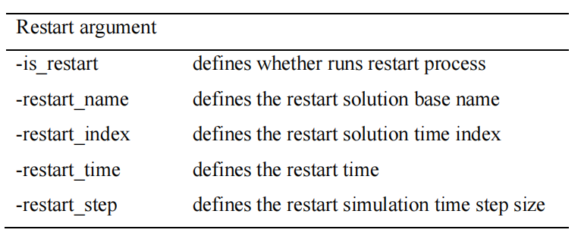
SUMMARY
Arguments

Slide 36
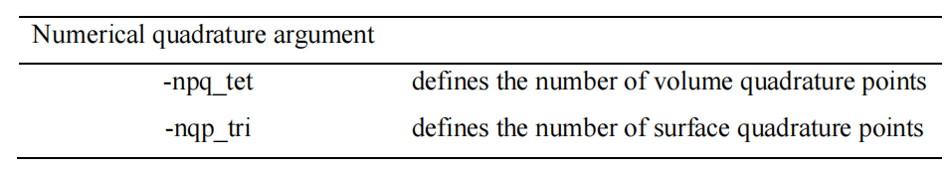
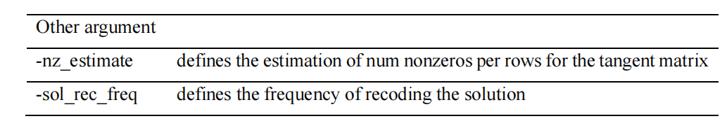
SUMMARY
Arguments

Slide 37
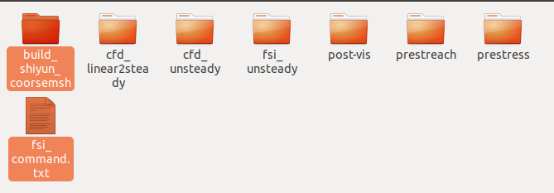
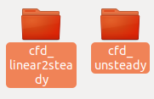


SUMMARY
Refercence
Folder path:
nas
build_shiyun_coorsemsh folder: contains cfd_linear2steady, cfd_unsteady, prestress, fsi_unsteady folder,
corresponding to the four processes of the simulation.

